Slide 1

Evaluating the Proficiency of ChatGPT in
Undergraduate Data Structures and Algorithms
20
24
An Analysis of Standardized Test Performance
By - Mokshith Ramendra Yaganti
20
24

Slide 2
Contents
Context | The Importance of DSA in AI Code Generation
Challenges | Variability in Code Efficiency and Correctness
Questions | Enhancing ChatGPT's DSA Performance
Hypothesis | The Impact of Prompt Engineering and Automated Evaluation
Design/Methodology | The design of the pipeline and Methodology
Data | Understanding the Input/Output and distribution of Data used.
Metrics | The key metrics used for performance evaluation
Results/Analysis | Results for each prompt and an analysis of performance
Limitations | Factors which limited the current study
Future scope | Actionable goals to expand the study
Appendix | Figures of topicwise performance of ChatGPT for every prompt - in order from 1-9

Slide 3

The Backbone of AI-Driven Software Development
Large Language Models (LLMs) like ChatGPT have revolutionized code generation, making strides in software development.
Data Structures and Algorithms (DSA) are pivotal for efficient code creation, affecting execution speed and resource management.
ChatGPT's proficiency in DSA underlines its potential as a powerful tool in software development, from problem analysis to creating algorithmic solutions.

Slide 4
Challenges in AI-Generated Code Quality
Discussion 1
Discussion 2
1
Despite ChatGPT's capabilities, there's a noticeable challenge in consistently generating efficient and correct code, especially in complex DSA tasks.
2
Variability in output quality highlights the need for refined interaction techniques to elicit high-quality code, addressing issues from minor bugs to system failures.
Traditional methods of evaluating AI-generated code often rely on manual strategies, limiting the scope and scalability of assessments.

Slide 5

The Quest for Optimal AI-Generated Solutions
How can prompt engineering influence ChatGPT's performance in solving undergraduate-level DSA problems?
The study focuses on whether strategic prompt design can lead to more accurate, efficient, and optimized solutions in code generation.
Investigates the potential of automating the study of ChatGPT's DSA code generation capabilities for a scalable and rigorous evaluation.

Slide 6
The Potential of Tailored Prompts and Automation
The hypothesis posits that through strategic prompt engineering, ChatGPT's ability to generate correct and efficient DSA solutions can be significantly enhanced.
Hypothesis 1
Employing an automated system for evaluating ChatGPT's code generation will offer a more scalable and objective assessment compared to traditional manual methods.
Hypothesis 2
This research aims to empirically test this hypothesis, exploring the relationship between prompt specificity, automated evaluation, and the quality of generated code solutions.

Slide 7
Design
01
02
03
04
Fetch
Prompt
Generate
Evaluate
Fetch questions, code stubs and test cases.
Create a set of prompts and leverage it as context for ChatGPT.
ChatGPT generates a solution given the prompt and prepared code stub
Generated solutions are tested against the test-cases.
Pipeline

Slide 8
Methodology
Methods
 | Fetch | A custom scraper was created to make an API call to the graphql db behind leetcode.com and fetch DSA questions along with the provided code stub and constraints. The test cases were also fetched and re-formatted as a pytest method.
 | Prompt | A set of 9 unique prompts are created which will be used as context for ChatGPT. The code stub and its corresponding question and constraints are prepared as one prompt string.
 | Generate | Given the context (prompt) and its corresponding question, an API request is made to ChatGPT to generate the solution.
 | Evaluate | Each solution is tested against it’s test-cases using pytest and the results are recorded for further performance analysis.

Slide 9
Data
Input |  |  | Output
Fetched | Processed |  | Solution: For each question a corresponding solution file is generated using the response from ChatGPT. Evaluation: Each solution file is tested and the evaluation results are recorded in a .csv file.
A total of ~550 standard DSA questions & constraints. Code stub provided by leetcode. Test cases provided as a pytest module. | Prompts
 | A set of 9 prompts carefully crafted to elicit various levels of expertise and solving capabilities.
 | Final Input
 | Context: Prompt ChatGPT prompt: Code stub, question, constraints as one string.

Slide 10
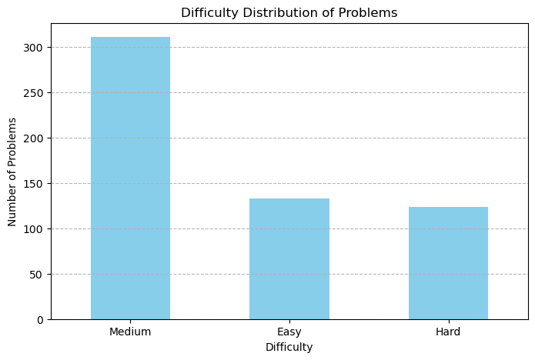
Data contd.
The questions are divided into the following categories for a diversified analysis of ChatGPT’s performance.
Easy - basic questions.
Medium - Advanced DSA or basic questions with harder twists.
Hard - Advanced DSA and advanced questions with harder twists.
Figure: This figures shows the distribution of the number of easy, medium and hard category questions. No. of questions for medium category is higher in aims for testing ChatGPT’s performance on a normal distribution of what a student might encounter in a real life coding round.

Slide 11
Metrics
The solutions generated by ChatGPT 3.5 are evaluated using the following metrics to establish a key benchmarking performance on standard undergraduate DSA questions.
Pass | Fail | Error | Acceptance
This metric indicates if the solution generated passes the test cases. Ex: The solution passes 2/3 test cases, then pass = 2 | This metric indicates if the solution generated fails the test cases. Ex: The solution passes 2/3 test cases, then fail = 1 | This metric indicates if the solution generated fails the test cases because of an error produced by the code. Ex: The solution passes 2/3 test cases & fails 1 because of an error, then Error = 1 | This is the key metric of choice which indicates if a generated solution passes all the test cases without any errors. Ex: The solution passes 3/3 test cases without any errors, then Acceptance = yes.

Slide 12
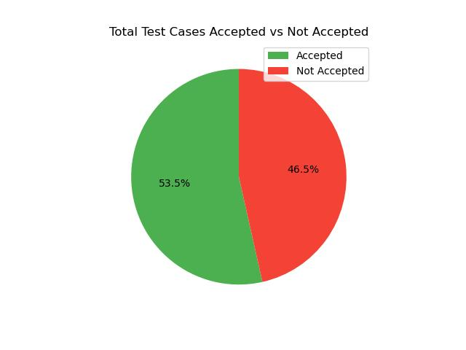
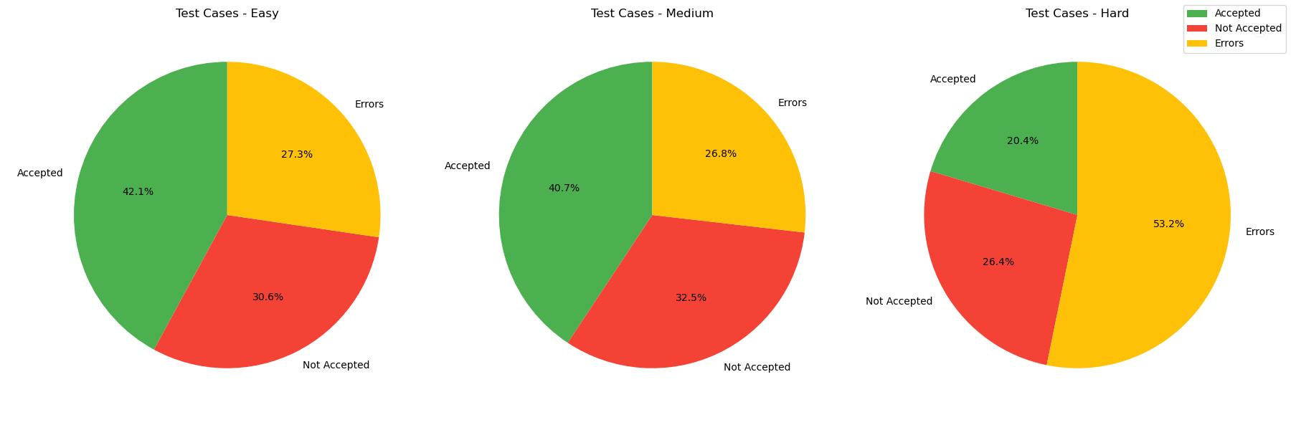
Results
For prompt 1: “Your role as an expert in Data Structures and Algorithms involves providing strictly accurate Python solutions. Provide only the code, with no extra text”
Figure: This figures shows the total percentage of the generated solutions accepted vs not accepted against their corresponding test-cases. This figure is also the key benchmark factor in evaluating the performance effects of each of the 9 prompts.
Figure: This figures shows the percentage of all the metrics for each of the categories mentioned earlier. It showcases how good ChatGPT is corresponding to the difficulty level of the question set.

Slide 13
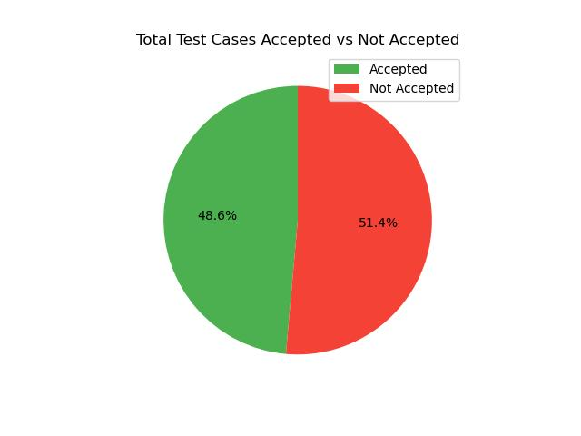
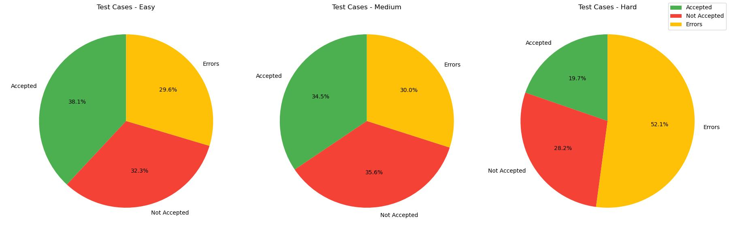
Results contd.
For prompt 2: “You, a Python expert specializing in data structures and algorithms, are tasked with writing a function based on the stub, strictly following the problem's specifications for optimal time and space usage. Avoid any additional text, focusing solely on the code.”
Figure: This figures shows the total percentage of the generated solutions accepted vs not accepted against their corresponding test-cases. This figure is also the key benchmark factor in evaluating the performance effects of each of the 9 prompts.
Figure: This figures shows the percentage of all the metrics for each of the categories mentioned earlier. It showcases how good ChatGPT is corresponding to the difficulty level of the question set.

Slide 14
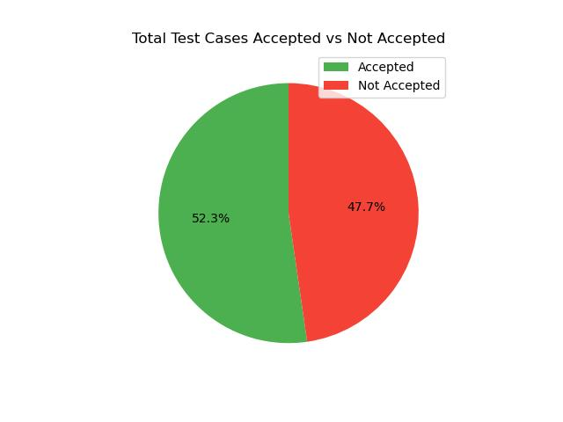
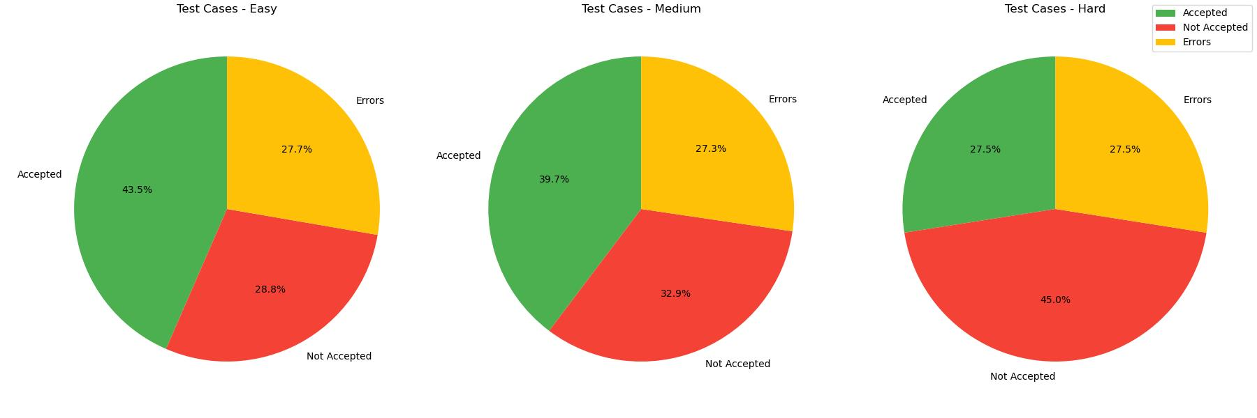
Results contd.
For prompt 3: “You are an expert in Data Structures and Algorithms & you only give accurate solutions in python. You do not generate any additional text apart from the code”
Figure: This figures shows the total percentage of the generated solutions accepted vs not accepted against their corresponding test-cases. This figure is also the key benchmark factor in evaluating the performance effects of each of the 9 prompts.
Figure: This figures shows the percentage of all the metrics for each of the categories mentioned earlier. It showcases how good ChatGPT is corresponding to the difficulty level of the question set.

Slide 15
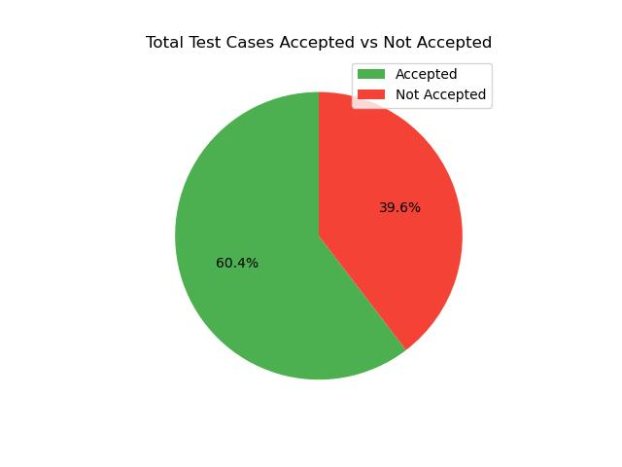
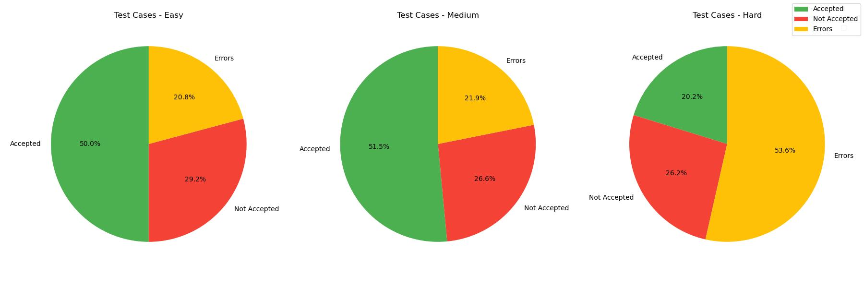
Results contd.
For prompt 4: “You are an expert Python developer focused on data structures and algorithms. Write an efficient Python function as provided in the code stub that adheres strictly to the problem's specifications and optimizes for both time and space. You do not generate any additional text or characters apart from the code”
Figure: This figures shows the total percentage of the generated solutions accepted vs not accepted against their corresponding test-cases. This figure is also the key benchmark factor in evaluating the performance effects of each of the 9 prompts.
Figure: This figures shows the percentage of all the metrics for each of the categories mentioned earlier. It showcases how good ChatGPT is corresponding to the difficulty level of the question set.

Slide 16

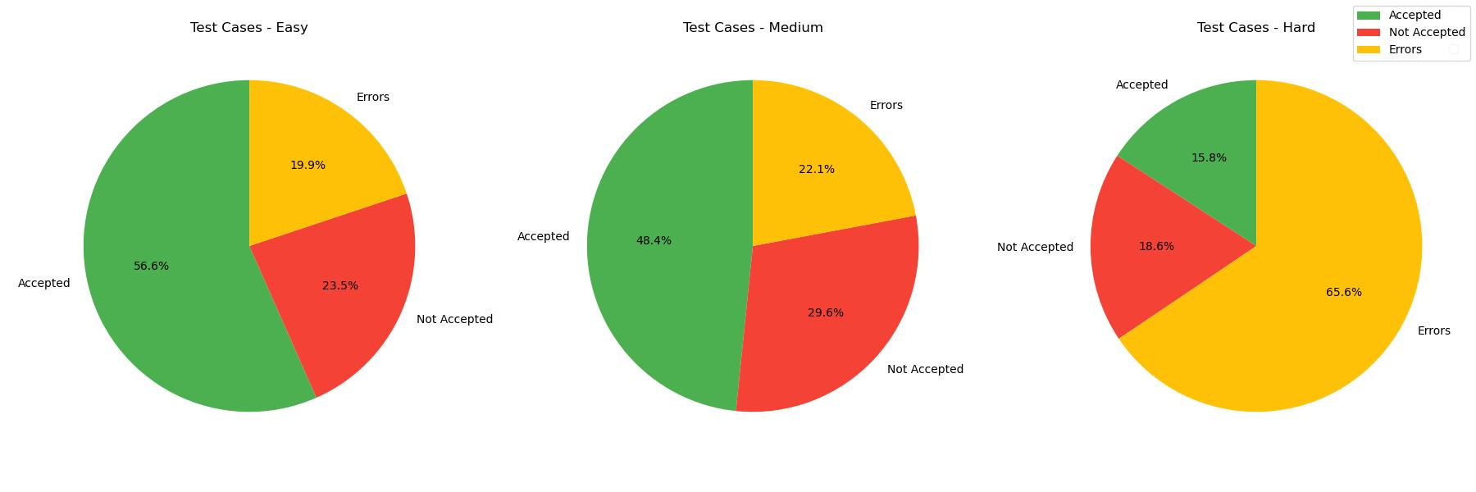
Results contd.
For prompt 5: “As a professional Python programmer specializing in data structures and algorithms, implement a solution for this LeetCode problem using the exact code signature provided. Ensure your code handles all constraints, edge cases and is optimized for performance. You do not generate any additional text apart from the code.”
Figure: This figures shows the total percentage of the generated solutions accepted vs not accepted against their corresponding test-cases. This figure is also the key benchmark factor in evaluating the performance effects of each of the 9 prompts.
Figure: This figures shows the percentage of all the metrics for each of the categories mentioned earlier. It showcases how good ChatGPT is corresponding to the difficulty level of the question set.

Slide 17
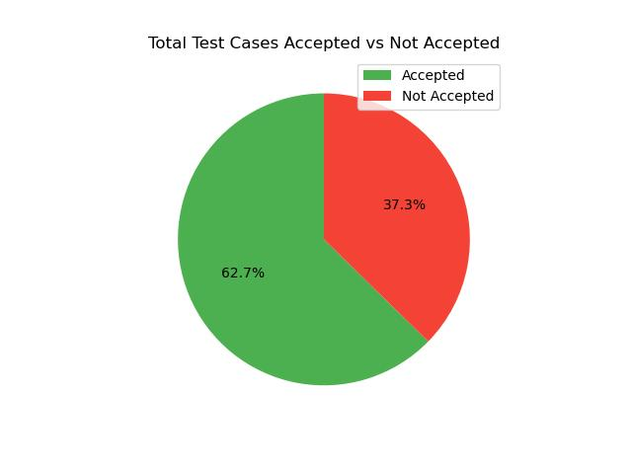
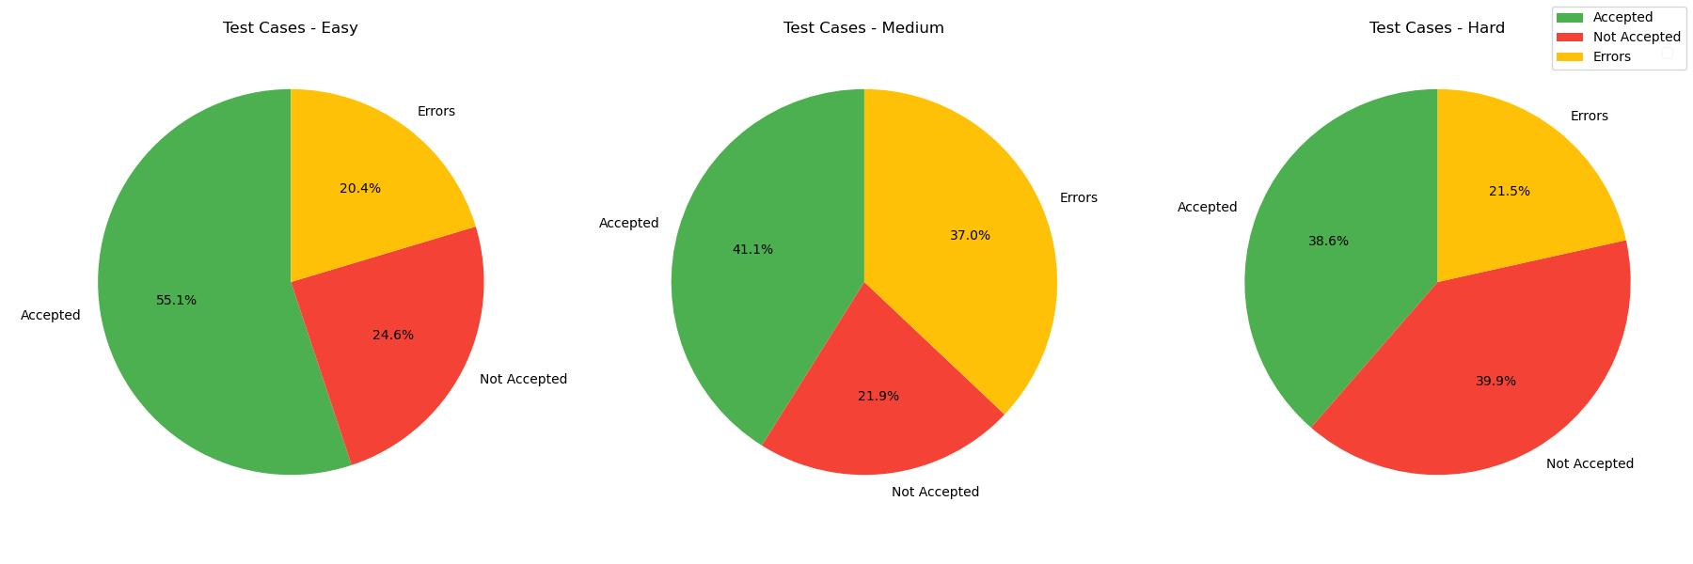
Results contd.
For prompt 6: “You are tasked as a Python software engineer to develop code solving this algorithmic challenge. Write the cleanest and most efficient code, considering all given constraints and using the specified function names. You do not generate any additional text apart from the code”
Figure: This figures shows the total percentage of the generated solutions accepted vs not accepted against their corresponding test-cases. This figure is also the key benchmark factor in evaluating the performance effects of each of the 9 prompts.
Figure: This figures shows the percentage of all the metrics for each of the categories mentioned earlier. It showcases how good ChatGPT is corresponding to the difficulty level of the question set.

Slide 18
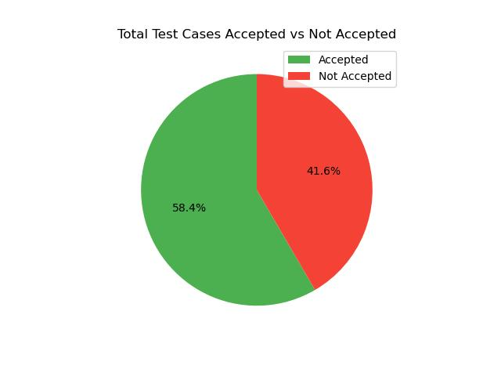
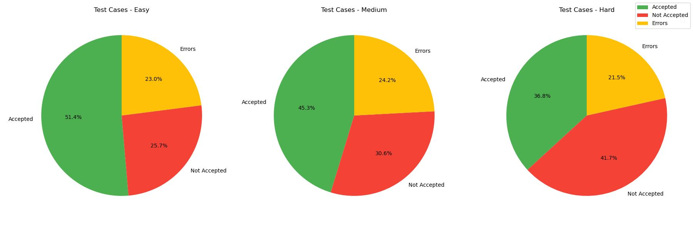
Results contd.
For prompt 7: “As a junior programmer, attempt to solve this problem in Python. Use what you’ve learned so far about data structures and algorithms. You do not generate any additional text apart from the code”
Figure: This figures shows the total percentage of the generated solutions accepted vs not accepted against their corresponding test-cases. This figure is also the key benchmark factor in evaluating the performance effects of each of the 9 prompts.
Figure: This figures shows the percentage of all the metrics for each of the categories mentioned earlier. It showcases how good ChatGPT is corresponding to the difficulty level of the question set.

Slide 19

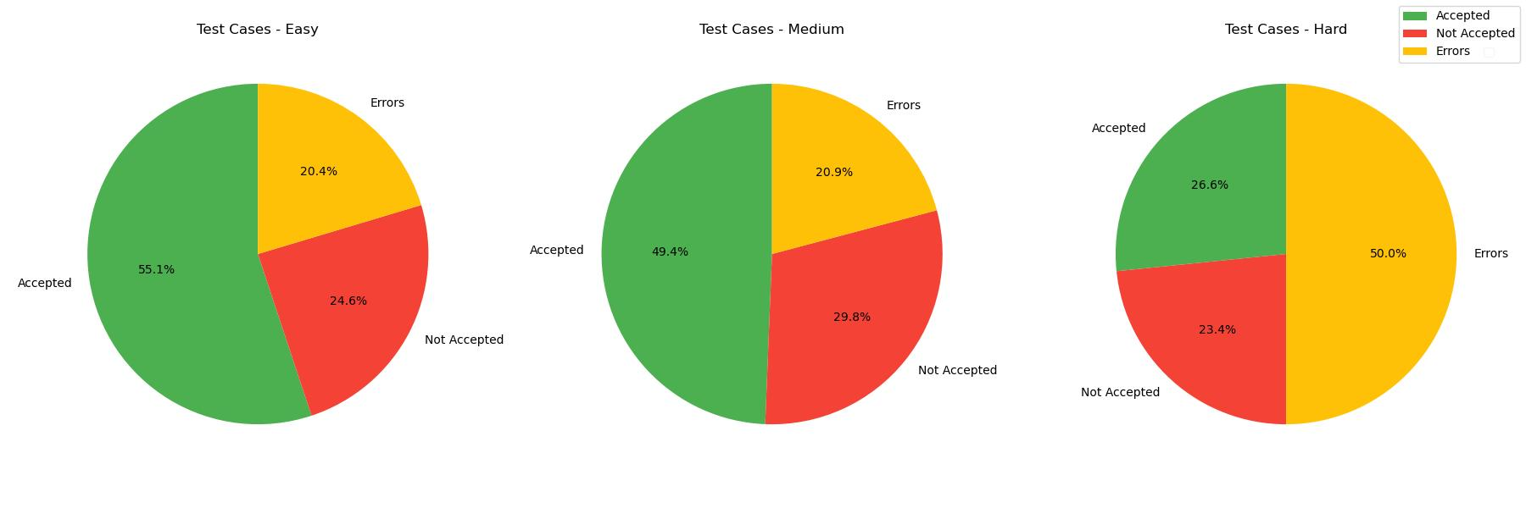
Results contd.
For prompt 8: “You are a software engineering student. Please try to write Python code to solve this problem based on your current knowledge. You do not generate any additional text apart from the code”
Figure: This figures shows the total percentage of the generated solutions accepted vs not accepted against their corresponding test-cases. This figure is also the key benchmark factor in evaluating the performance effects of each of the 9 prompts.
Figure: This figures shows the percentage of all the metrics for each of the categories mentioned earlier. It showcases how good ChatGPT is corresponding to the difficulty level of the question set.

Slide 20

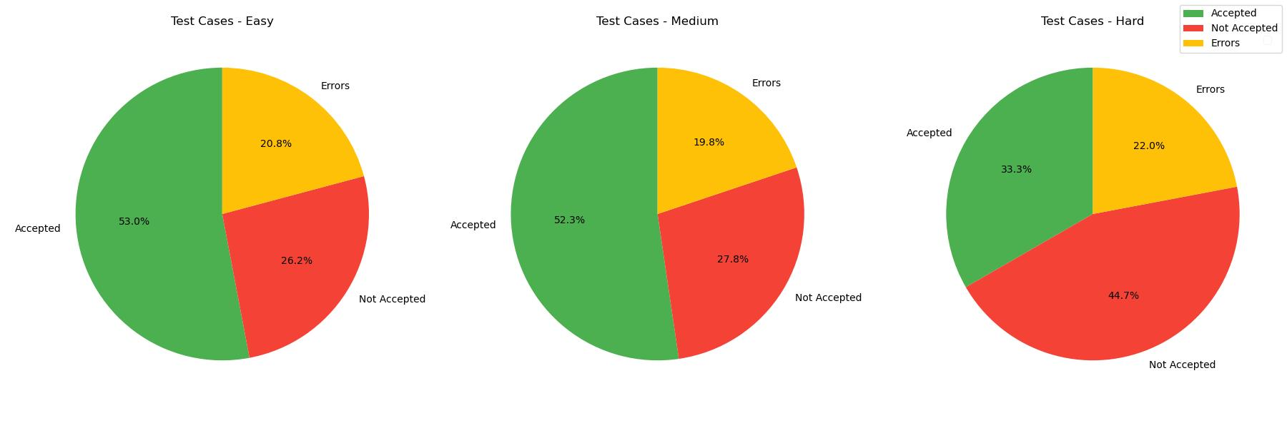
Results contd.
For prompt 9: “As an enthusiastic hobbyist coder, draft a Python script to tackle this algorithm problem efficiently. You do not generate any additional text apart from the code.”
Figure: This figures shows the total percentage of the generated solutions accepted vs not accepted against their corresponding test-cases. This figure is also the key benchmark factor in evaluating the performance effects of each of the 9 prompts.
Figure: This figures shows the percentage of all the metrics for each of the categories mentioned earlier. It showcases how good ChatGPT is corresponding to the difficulty level of the question set.

Slide 21
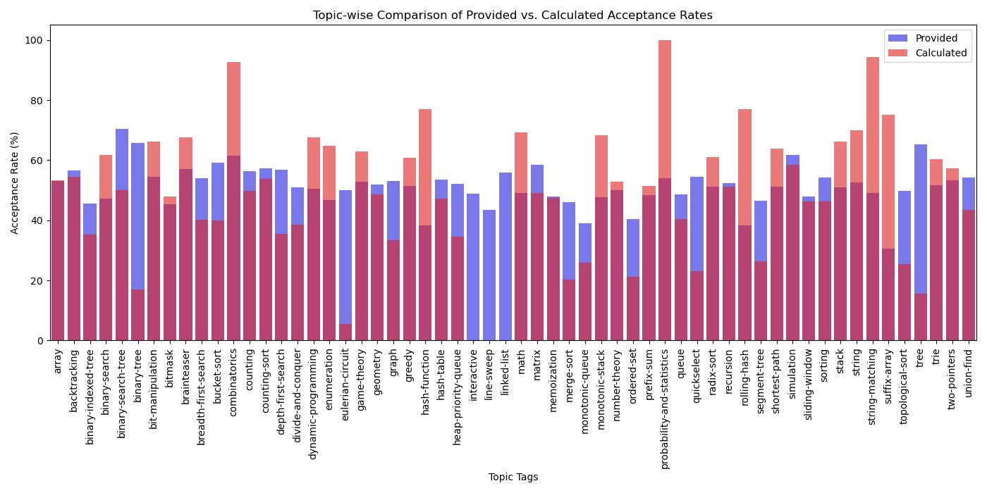
Analysis
Figure: This figures shows how good/bad the performance of ChatGPT is with respect to the average acceptance rate of the general public’s solutions (provided by leetcode) per topic. It clearly indicates the topics ChatGPT 3.5 exceeds humans by a huge margin and also the topics where it lacks severely. This figure provides a key average understanding of the performance of ChatGPT on DSA questions overall and also shows the specific scope for improvement.

Slide 22
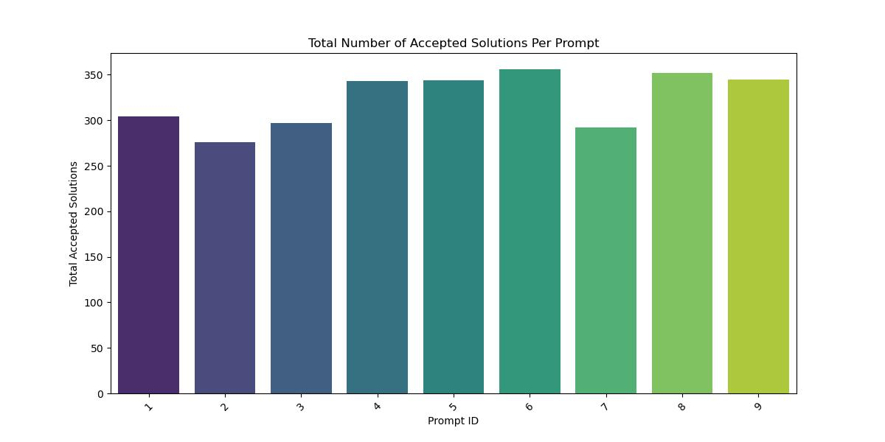
Analytics contd.
Figure: This figures shows the performance effect of each of the 9 prompts on the number of solutions accepted. It clearly shows that prompt number 6 is the best performing prompt and prompt number 2 being the worst of the bunch. This analysis also helps understand the various prompt verbage and its effect in enhancing performance in the projects context.

Slide 23
Limitations
ChatGPT’s API allows approximately 550 questions to be processed with the same context. This effectively sets a hard limit on the number of questions a certain prompt can be evaluated on.
Leetcode currently does not have a full end-to-end API system to request questions, code stubs, constraints and test cases. Therefore querying the graphql behind leetcode was written from scratch to obtain the desired information.
Additionally, since there is no functionality for submitting the ChatGPT generated solutions directly to leetcode, only the visible test-cases were fetched and used for evaluation, limiting the study to not include the comprehensive list of hidden test-cases.
ChatGPT 3.5 was used to conduct the study as the cost of making API calls to ChatGPT 4 is budget limiting.

Slide 24
Future Scope
This study can be expanded to include the performance analysis of a greater number of context prompts (~50) to truly evaluate the effect of prompting in performance boosting.
Larger context prompts can potentially improve the throughput of good solutions and must be tested.
LLM’s such as Llama 3, Claude & other open source models can also be evaluated to obtain a comprehensive view of the performance of these models on DSA questions.

Slide 25
Thanks!
Do you have any questions?
myaganti@leomail.tamuc.edu

Slide 26
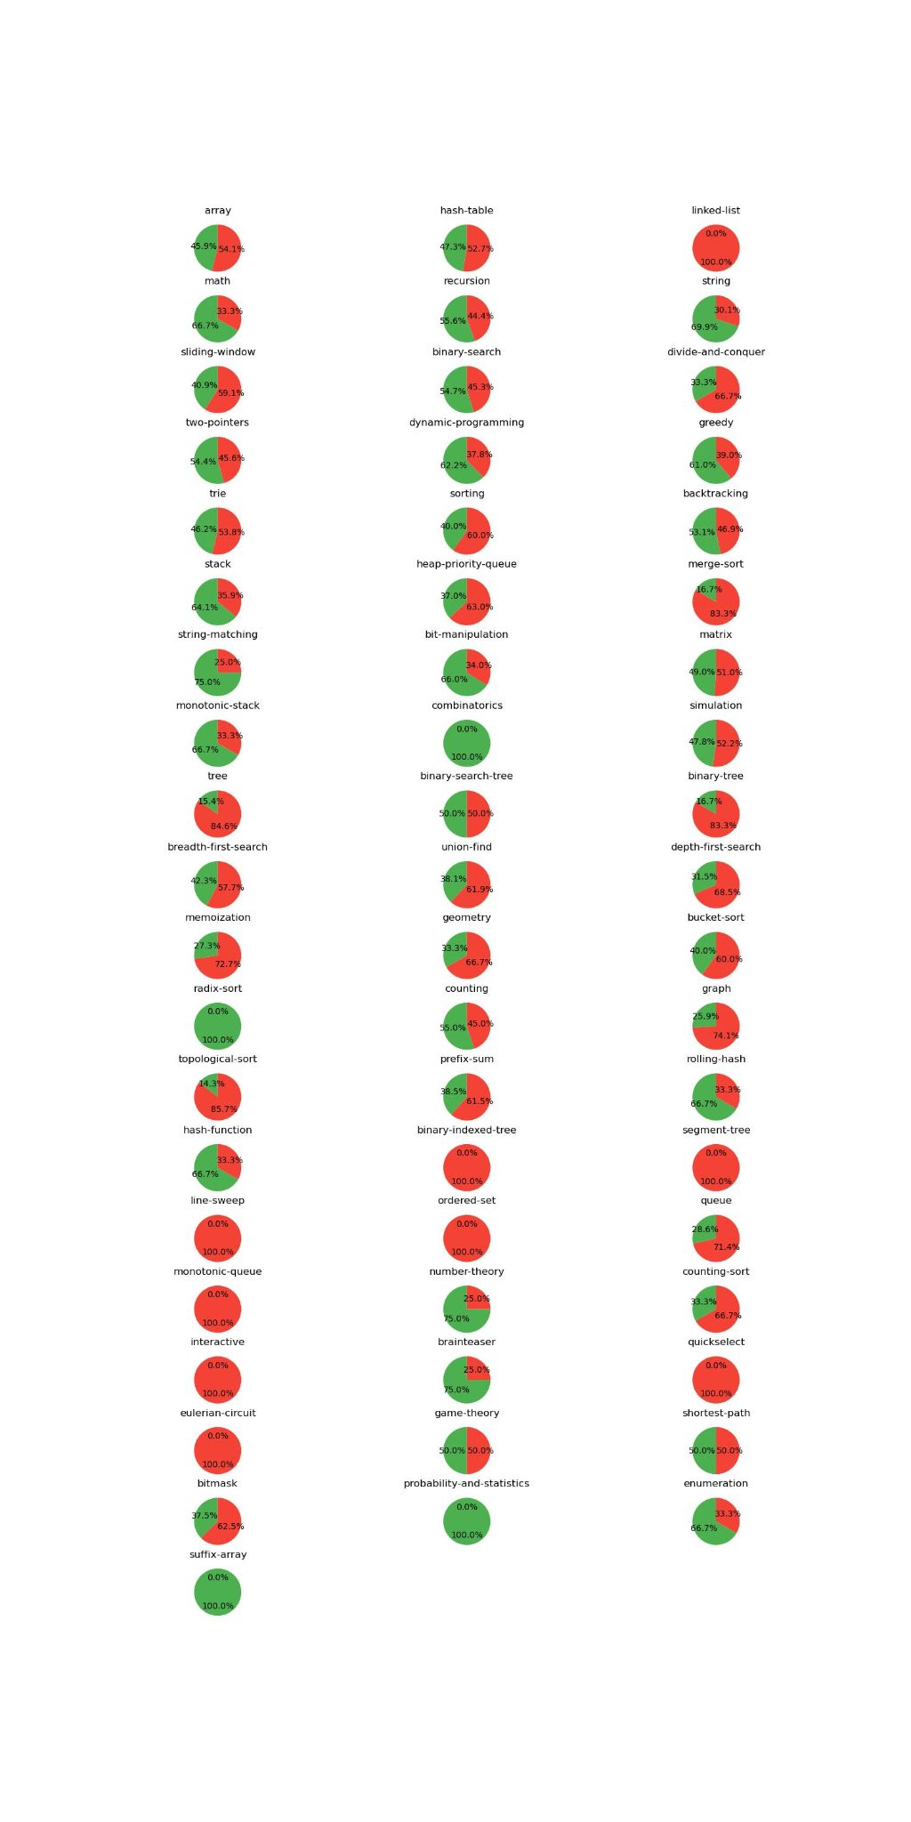
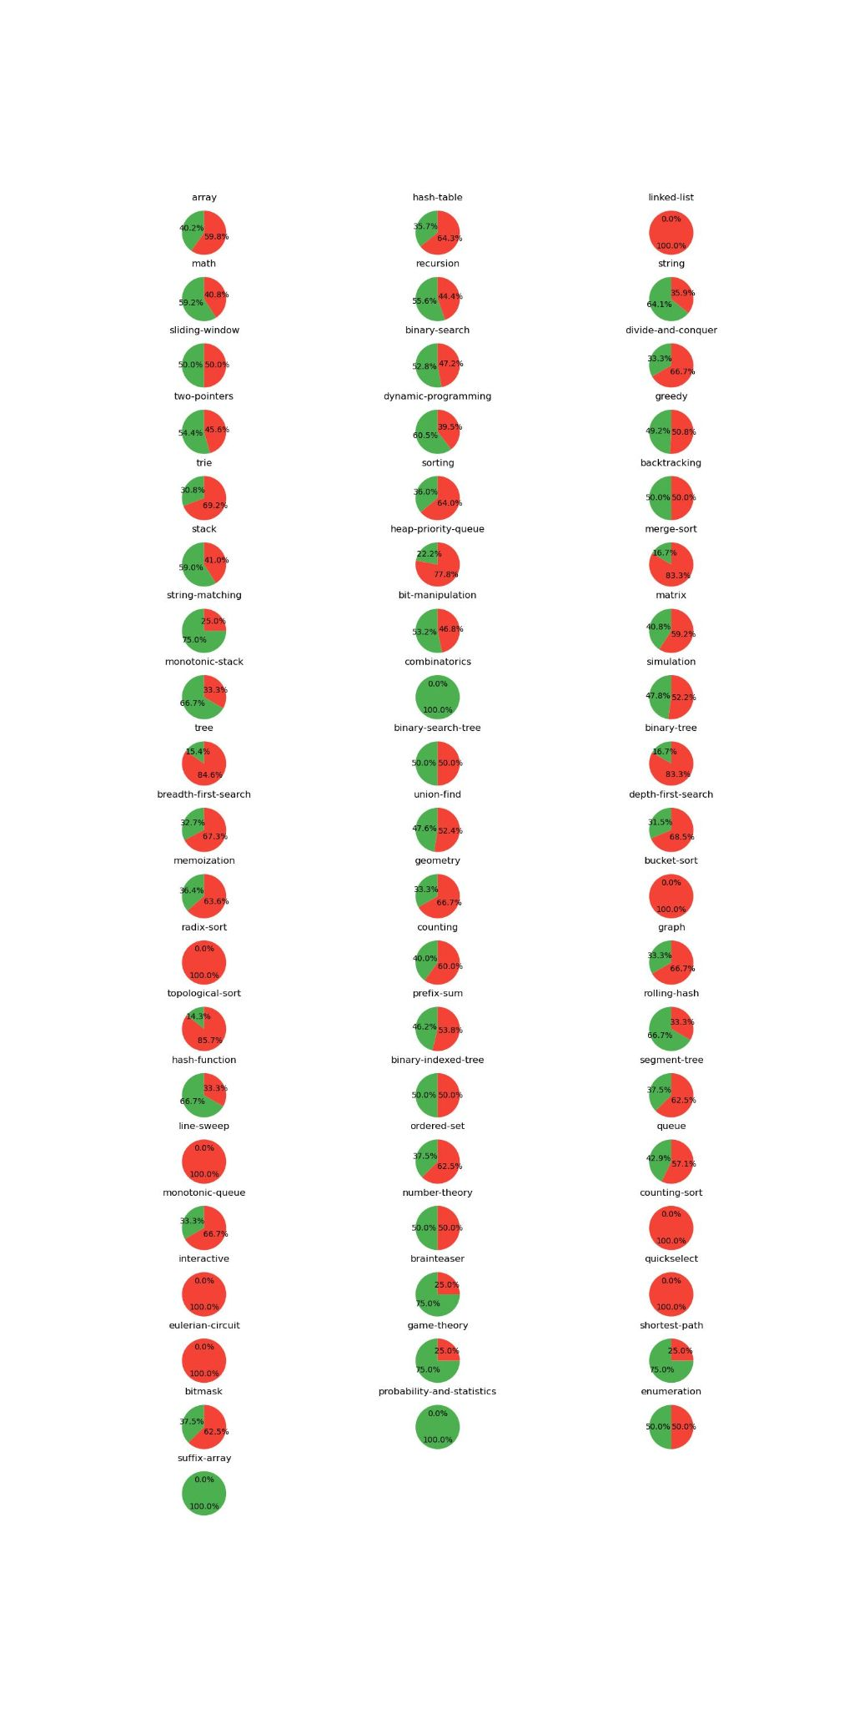
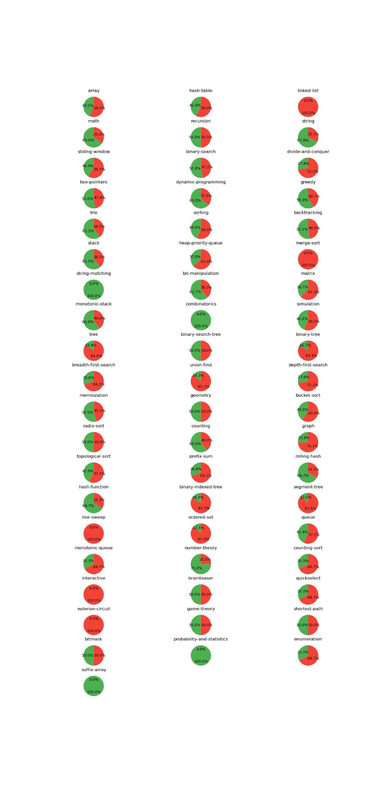
Appendix

Slide 27
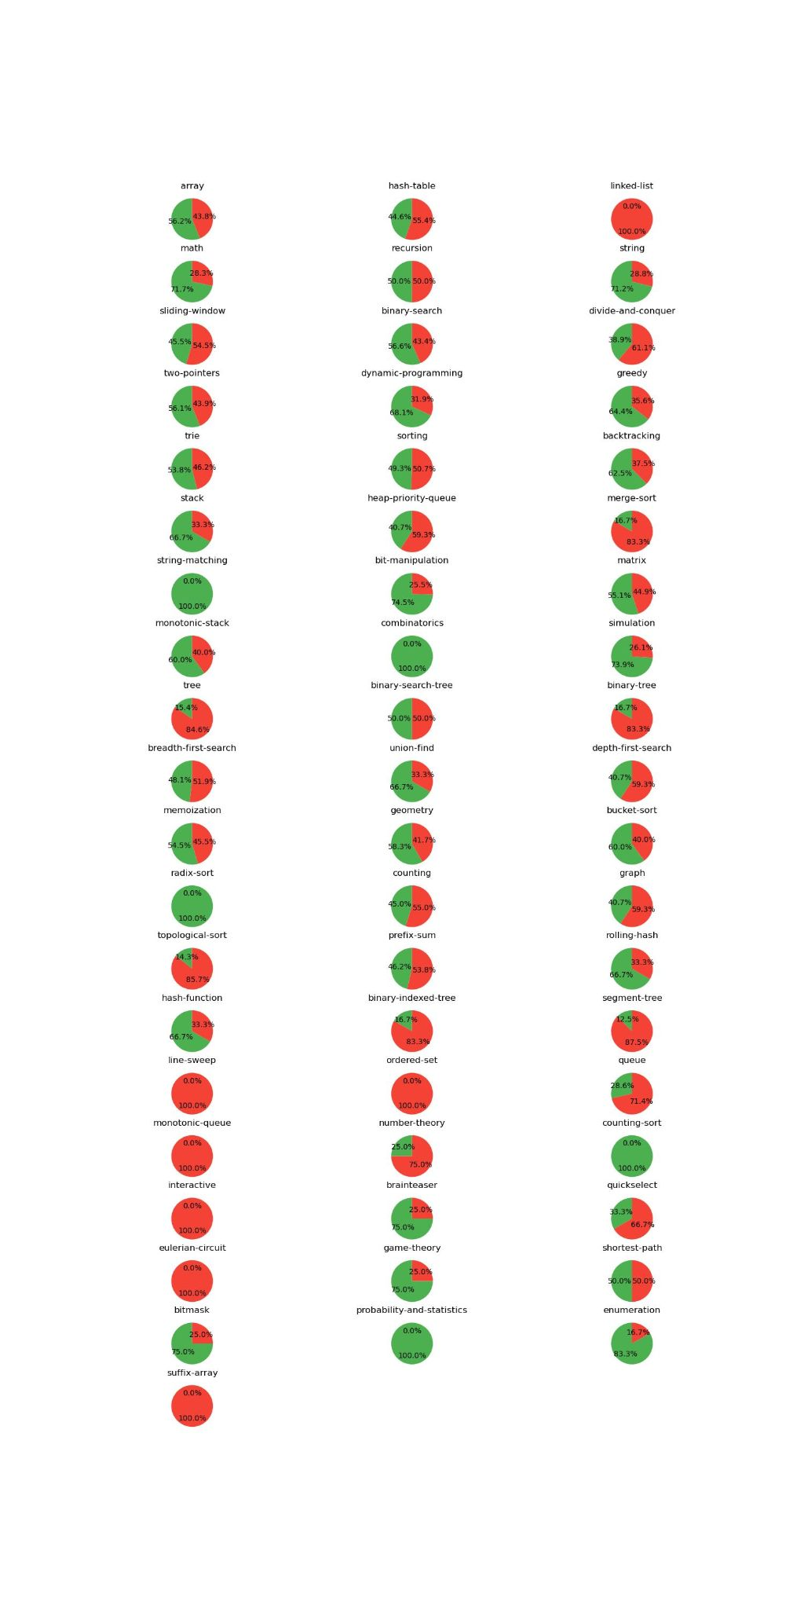
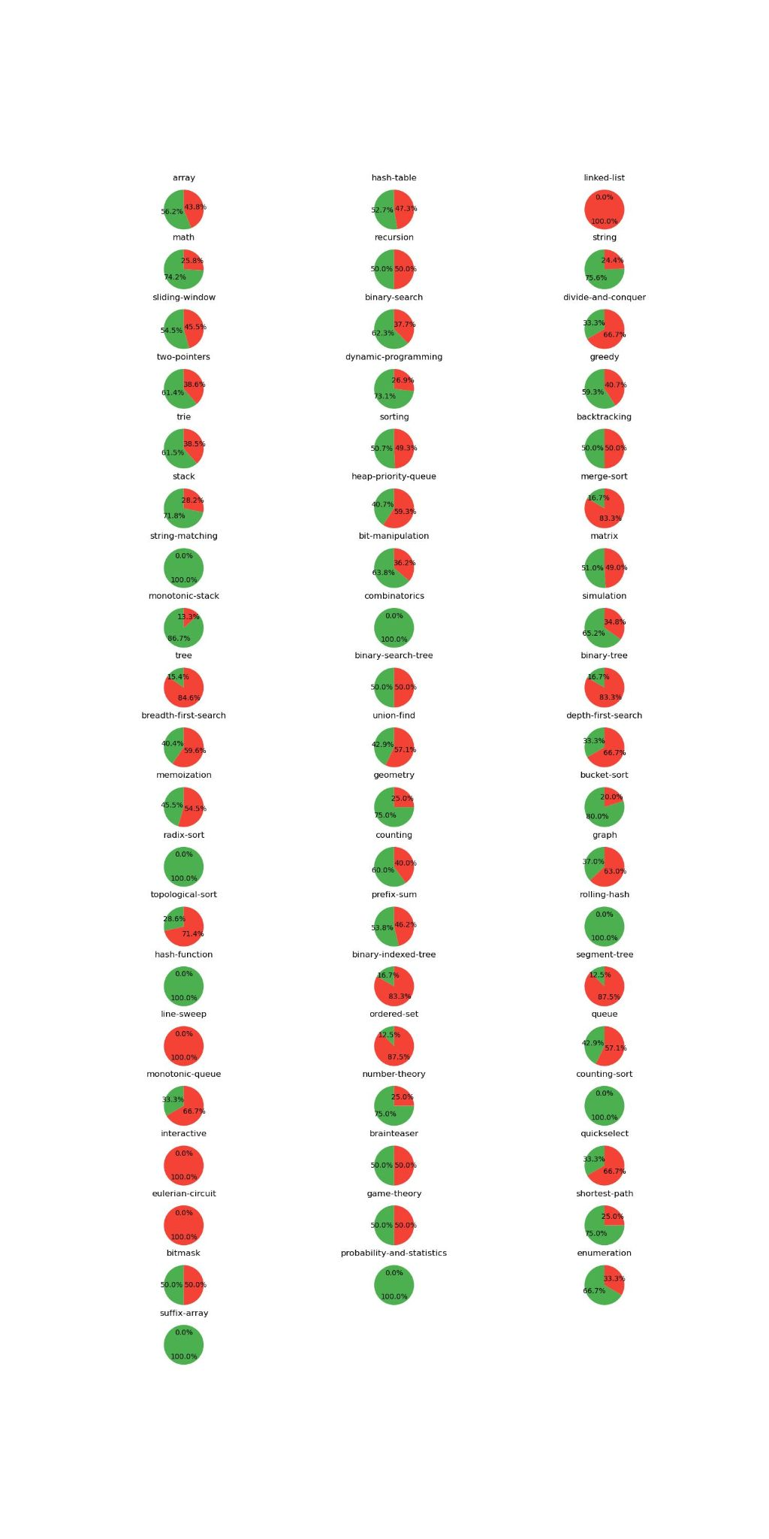

Appendix contd.

Slide 28
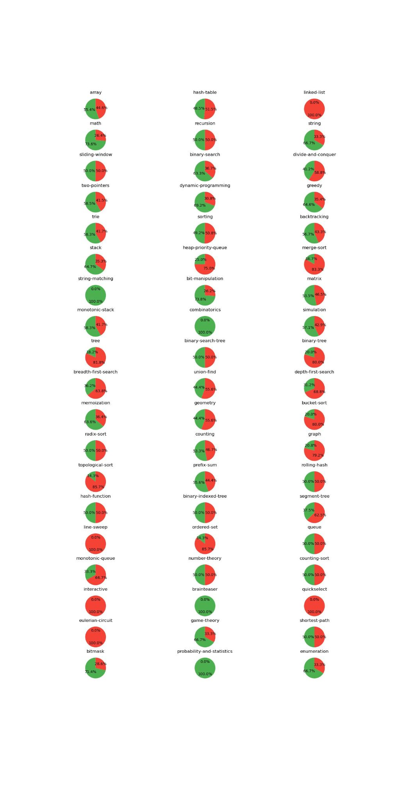

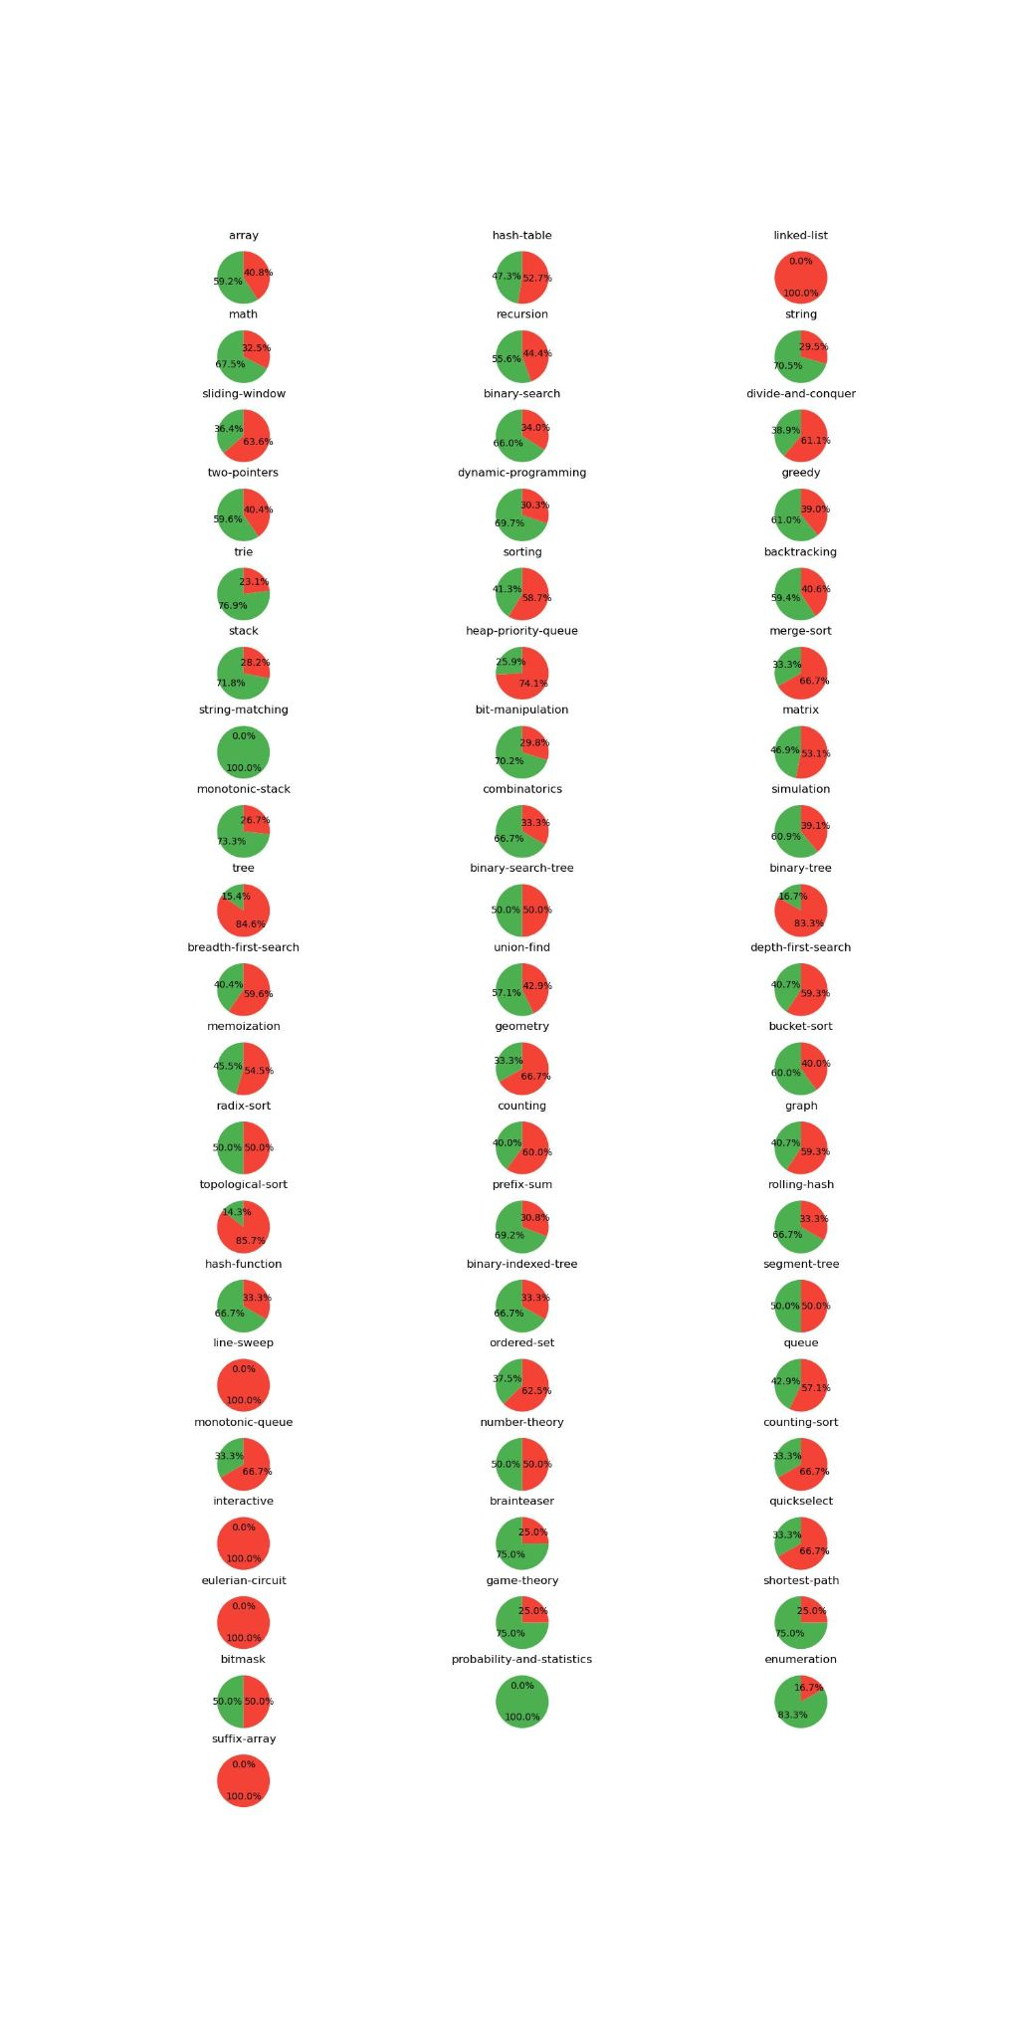
Appendix contd.

